Slide 1


SeaLane2020
Augmented Vision

Slide 2
MISSION
Create an app to allow surface navigation in fog/night conditions with
little or no forward visibility.
Provide visual indication of obstacles ahead.

Slide 3

THE TEAM
Tampa Deep Sea Xplorers
We are a diverse group of scientists, engineers, makers, and enthusiasts assembled to tackle the Shell Ocean Discovery XPRIZE and a number of other challenges along the way.
▪︎Ed Larson ▪︎Chuck Begian ▪︎Art Ianuzzi
▪︎David Meiller ▪︎Nung Bedell ▪︎Renier Oliva
▪︎Abhishek Shrivastava

Slide 4

GOAL ONE
MOBILE A/R APP
Incorporate Navigation, AIS, Display, and Vizmute features into a common mobile device app.

Slide 5
GOAL 1 – MOBILE A/R APP
Navigation Route Requirement
GPS Waypoints and/or visual representation of the route so boat pilot does not have to look at console to stay on course.

Slide 6
GOAL 1 – MOBILE A/R APP
Navigation Route Requirement
GPS Waypoints and/or visual representation of the route so boat pilot does not have to look at console to stay on course.
Navigation Display Solution
Magnetic Heading, Magnetic Course, Speed, Current Time
Dynamic Depth Readout
GPS Moving Map Inset
FLIR for obstacle detection and collision avoidance
IR View for Situational Awareness
Visual Indication of GPS Waypoints and Known Obstacles
Synthetic Course Guidance
Night Vision-Saving Red Light Display
Vessel can be piloted entirely by reference to A/R display.

Slide 7
GOAL 1 – MOBILE A/R APP
AIS Information Display Requirement
Ship location data from AIS Navigation Plotter.

Slide 8
GOAL 1 – MOBILE A/R APP
AIS Information Display Requirement
Ship location data from AIS Navigation Plotter.
AIS Information Display Solution
AIS provided location of nearby ships indicated on display.
Ship heading and speed information could be added as a future enhancement.

Slide 9
GOAL 1 – MOBILE A/R APP
Manual Data Display Requirement
Known obstacles, danger areas, buoys, markers, etc.

Slide 10
GOAL 1 – MOBILE A/R APP
Manual Data Display Requirement
Known obstacles, danger areas, buoys, markers, etc.
Manual Data Display Solution
Known navigation routes, navigation fixes, and buoy locations displayed from maritime navigation data sources.

Slide 11
GOAL 1 – MOBILE A/R APP
Vizmute Requirement
Immediately “mute” visual indicators on demand.

Slide 12
GOAL 1 – MOBILE A/R APP
Vizmute Requirement
Immediately “mute” visual indicators on demand.
Vizmute Solution
User can individually “mute” (remove from display) each type of indicator with a single button press.
One touch visual muting of ALL indicators.(display “de-clutter” button)
User can also select full color, monochrome, IR, and Red Light display.
IR is an overlay on live video and can be toggled between 25%, 50%, and 75% transparency as needed

Slide 13
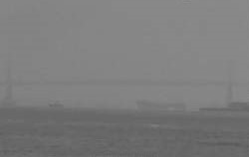
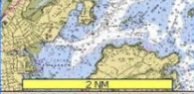
MAG CRS 121 MAG HDG 118 SPEED 3.4 KTS DEPTH 24 FT 14:51:20Z
ALL
ON/OFF
DISPLAY
IR
NAV
OFF
DEPTH
OFF
OBSTACLE
OFF
OVERLAY
OFF
Exxon Valdez
WPT
036
PT471
*
*
*
*
*
*
*
*
*
*
*
*
*
*
*
*
MAP
OFF
Display
Brightness

Slide 14
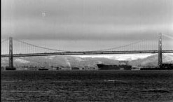
MAG CRS 121 MAG HDG 118 SPEED 3.4 KTS DEPTH 24 FT 14:51:20Z
ALL
OFF
DISPLAY
VISIBLE
NAV
OFF
DEPTH
OFF
OBSTACLE
OFF
OVERLAY
OFF
*
*
*
*
*
*
*
*
*
*
*
*
*
*
*
*
MAP
OFF
Display
Brightness

Slide 15
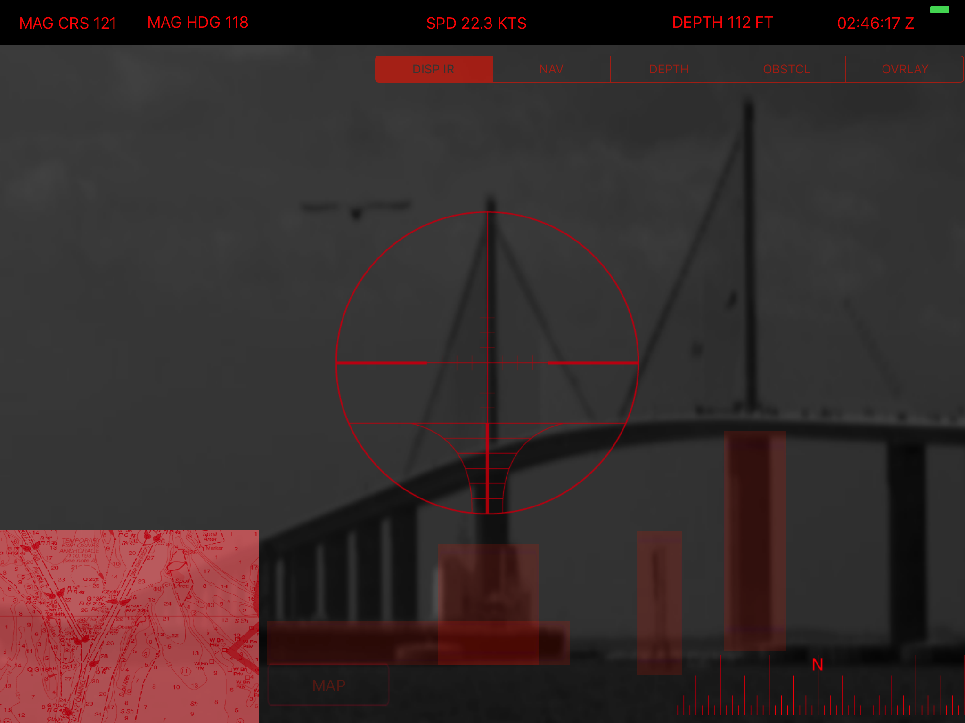
GOAL TWO
VIDEO OF A/R APP
Present a video representing the app in action. Demonstrate control features, object recognition among some of the other requirements.

Slide 17
GOAL 2 – Video of Low-Light
Maritime Navigation Using App
Brightness Adjustment Requirement
A/R adjusts display based on light levels.

Slide 18
GOAL 2 – Video of Low-Light
Maritime Navigation Using App
Brightness Adjustment Requirement
A/R adjusts display based on light levels.
Brightness Adjustment Solution
The ambient light sensor on the Android device is used to adjust A/R display brightness.
User can override by adjusting display brightness manually.

Slide 19
GOAL 2 – Video of Low-Light
Maritime Navigation Using App
Matching of Detected Objects to Virtual Icon Requirement
Integrate object detection to match virtual icons to real-world objects, or identify real-world objects not present in existing data sources (map, AIS, etc.)

Slide 20
GOAL 2 – Video of Low-Light
Maritime Navigation Using App
Matching of Detected Objects to Virtual Icon Requirement
Integrate object detection to match virtual icons to real-world objects, or identify real-world objects not present in existing data sources (map, AIS, etc.)
Matching of Detected Objects to Virtual Icon Solution
OpenCV could be used for object recognition, and if target speed and heading are available, some correlation of virtual icons to real-world objects can be done.
However, the amount of available memory and computing power on the Android device limits its ability to identify and classify real-world objects from available sensor data. This is not a MASINT platform.

Slide 21
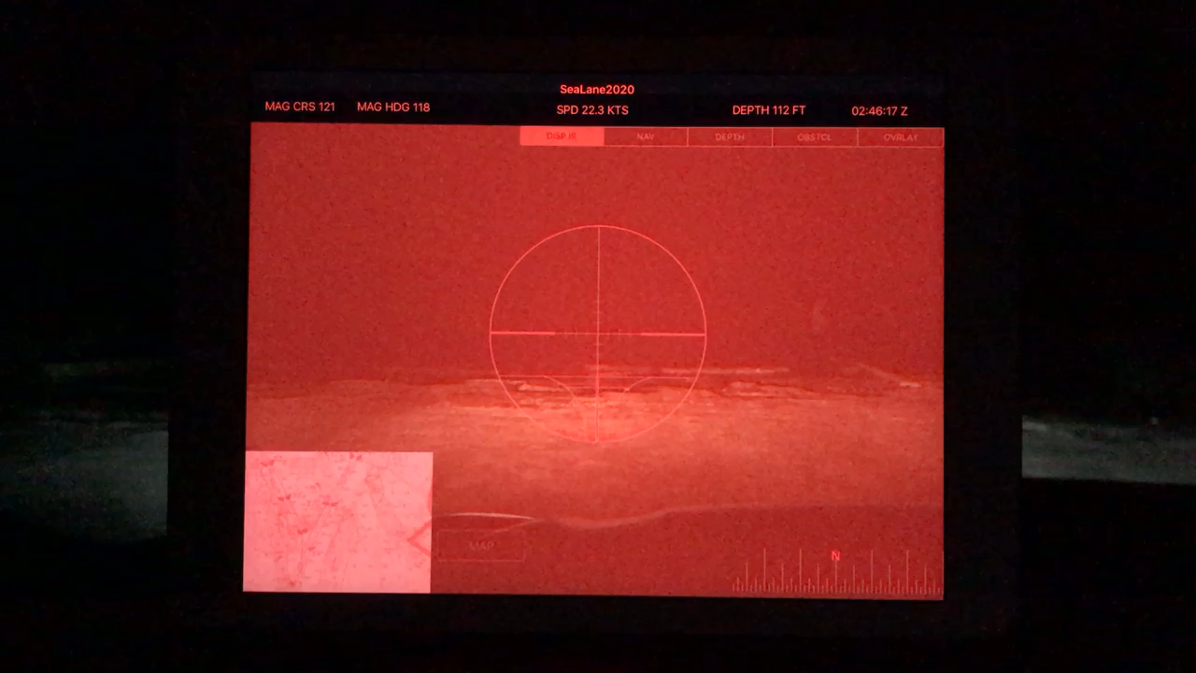

Slide 22
Sea Lane 2020
Summary
Meets the core requirements of the Fog Breaker Challenge
Additional enhancements to improve usefulness, safety, and stealth
Useful for military and civilian use
This application has been accepted to compete for the HeroX Big Ocean Button Challenge

Slide 23
THE PLAN &CODE
https://github.com/TampadeepseaX/SeaLane2020

